Slide 1
BANKA BIOLOO LIMITED Leading India's Sanitation & Wastewater Treatment Revolution
Investor Presentation
30th September 2023

Slide 2
About Banka Bio
Banka BioLoo Limited is a social impact organization that strives to improve lives by bringing innovation in the water, sanitation and hygiene (WaSH) facilities, through research, design, partnerships, and education.
We have partnered with DRDO for technology commercialization for large-scale deployment of sanitation systems. We provide sanitation operations & maintenance (O&M) services to one of the largest rail networks globally, the Indian Railways, and ensure a pleasant travel experience for millions of passengers every day.
Banka Bio business’ majorly focuses on (i) Waste Management (Bio-toilets, FSTP) (ii) Wastewater Treatment/Management and (iii) Water Conservation
Water Conservation
Waste Management
(Bio-toilets, FSTP)
Wastewater Treatment/ Management

Slide 3
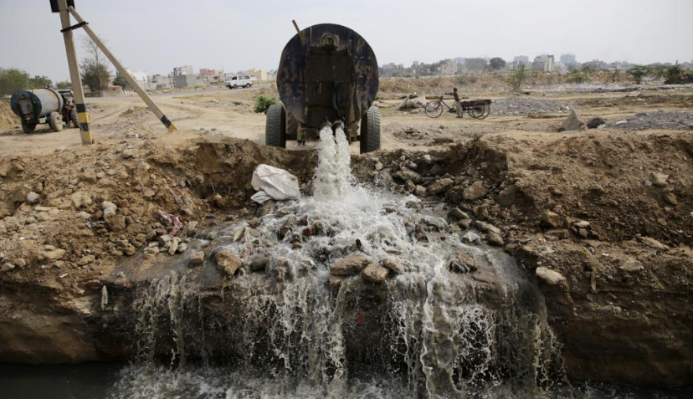
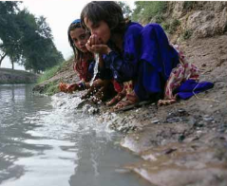
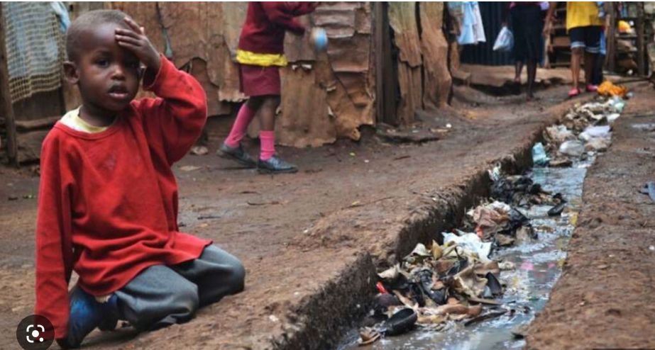
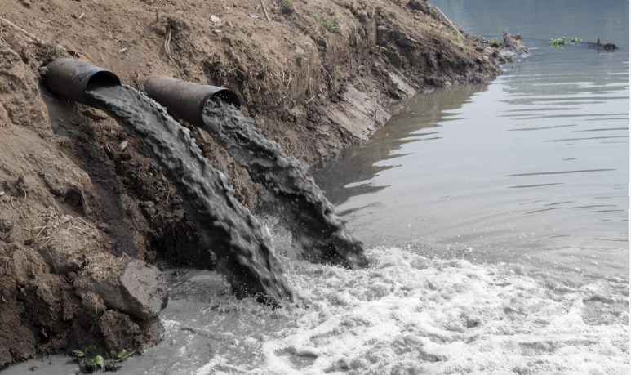
Problem
Our Solutions
Globally, 3 Billion people are experiencing inadequate sanitation and depleting water quality
BANKA BIO curates waste & wastewater treatment technologies for your community to give you a sustainable solution.
Bio Toilets
Bio Toilets O&M and equipments for Railways
Used Water Management
Packaged Sewage Treatment Plant (PSTPs) / Conventional STP plants
UrbanSaaS ( STP-as-a-service) for residential/commercial/industrial applications
Feacal Septage Plant Treatment Plant (FSTPs)
Strictly Private & Conﬁdential. Not for Circulation

Slide 4
Financial Performance (in lakhs)
Profit After Tax
Turnover
Sept 23
Half Year
Sept 22
Half Year
Sept 23
Q3
June 23
Q2
Sept 23
Half Year
Sept 22
Half Year
Sept 23
Q3
June 23
Q2
Earnings Per Share
EBDITA
Sept 23
Half Year
Sept 22
Half Year
Sept 23
Q3
June 23
Q2
Sept 23
Half Year
Sept 22
Half Year
Sept 23
Q3
June 23
Q2

Slide 5
Partial client list
Strictly Private & Conﬁdential. Not for Circulation

Slide 6
Thank You
+91 7780301502
+91 8688825013
info@bankabio.com
cs@bankabio.com
www.bankabio.com

